Slide 1



Be Bold
Stay Curious
(and a little disruptive)
https://globalstrategicsolutions.com/2020/07/19/potential-benefit-versus-potential-risk-residual-risk/
Potential Benefit versus Potential Risk
(Residual Risk)
https://globalstrategicsolutions.com/2020/02/21/mythical-medical-and-the-unsolvable-equation-benefit-to-risk-analyses/
David R Rutledge, Pharm.D., FCCP, FAHA
President & CEO
Global Strategic Solutions, LLC
+1 (630) 846-0350 cell
David.Rutledge@globalstrategicsolutions.com
www.globalstrategicsolutons.com
https://www.linkedin.com/in/david-rutledge-9291609/

Slide 2

An ISO Standard, Guidance Documents and a Textbook to Organize Thinking to Craft Benefit-to-Risk Assessments for your Product
ISO14971:2019 Medical devices – Application of risk management to medical devices
FDA Guidance “Factors to Consider When Making Benefit-Risk Determinations in Medical Device Premarket Approval and De Novo Classifications” issued August 30, 2019. It contains worksheets and examples.
FDA Guidance “Consideration of Uncertainty in Making Benefit-Risk Determinations in Medical Device Premarket Approvals, De Novo Classifications, and Humanitarian Device Exceptions” issued August 30, 2019.
A textbook I would recommend is Safety Risk Management for Medical Devices by Bijan Elahi ISBN 978-0-12-813098-8 by Elsevier Publishing under the label of Academic Press 2018.
Benefit-versus-Risk – Units of Measures Differ
“The Unsolvable Equation”
Because the speed of light is a very large number and is multiplied by itself, this equation points out how a small amount of matter can release a huge amount of energy, as in a nuclear reaction.
2

Slide 3

Bring A Team Together
You cannot do this on your own, you need a team
Clinical Research (clinical science)
Clinical Evaluation
Medical Affairs
Quality
Risk management including product/ clinical/software/
cybersecurity representation
Labeling
Regulatory Affairs
Engineering
Biostatistics
Complaint Handling
Clinical Safety
Others
(External Healthcare Providers, Patient Advocacy Groups, etc.)
A Framework For Discussion
“The Unsolvable Equation”
3

Slide 4
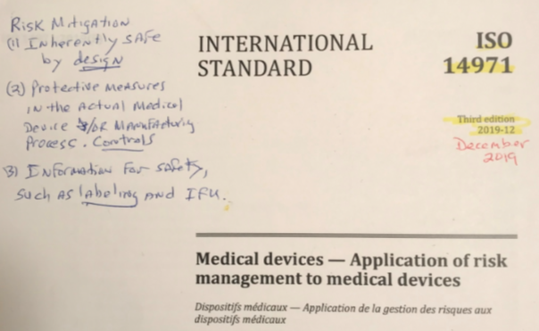
ISO14971:2019 Risk Management for
Medical Devices
Defines benefit as having a positive impact or desired outcome of the use of a medical device on the health of an individual, or a positive impact on patient management or public health.
Benefits can include a positive impact on:
a. clinical outcomes
b. the patient’s quality of life
c. outcomes related to diagnosis
d. impact from diagnostic devices on clinical outcomes
e. impact on public health
This team should use all available clinical data, including results from clinical investigations or registries, hospital databases, usability, servicing records, CAPAs, customer/patient feedback, literature, etc.
4

Slide 5

Discuss Potential Benefits: Address these 12 issues if they apply
Patient perspective, such as quality of life from a validated tool
Healthcare professionals and caregivers' perspectives
Medical necessity, e.g., What are the other choices to patients/health
care practitioners that would make this product a benefit?
Types of benefits (remember that claims should automatically be
considered types of benefits)
Magnitude of benefits in terms of time or scale so a metric can
be used here
Likelihood or probability of experiencing one or more benefits
Reduction in the probability of death
Aiding improvement in patient function such as an organ system
Reducing the probability of loss of a function
Relief of symptoms
Duration of benefits in terms of curative, short-term, or long-term
Benefits when compared to alternative therapies or state-of-the-art
5

Slide 6

Create Narratives Around Seven, Broad Benefit Assessment Criteria
A Framework For Discussion
Types of benefits
Magnitude of benefits
Likelihood of experiencing one or more benefits
Duration of effects
Patents’ perspective on benefit
Benefit factors for health care professionals or caregivers
Medical necessity compared to what is currently available, for example
If assumptions are being made, make them clear to the team.
6

Slide 7

Address Uncertainties In Potential Benefits
Finally, uncertainties in benefits need to be addressed and might be related to sensitivity, specificity, accuracy, precision, reproducibility, wide confidence intervals, underpowered studies, missing data, or the impact of confounding interventions or physiological or pathophysiological factors.
7

Slide 8
Benefit Assessment – Template for Brainstorming
Benefit Assessment Criteria | Assessment for Device or Device System
Types of Benefits
Magnitude of Benefit
Likelihood of Experiencing One or More Benefits
Duration of Effects
Patients’ Perspective on Benefit
Benefit Factors for Health Care Professionals or Caregivers
Medical Necessity Compared to What is Currently Available
*Add references here
8

Slide 9
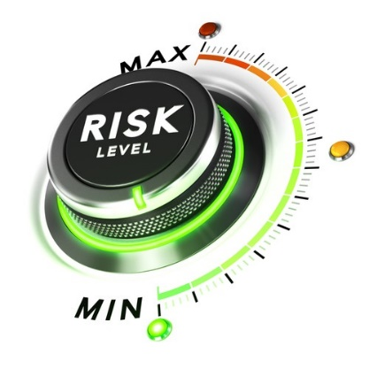
Discuss Potential Risks: Address these 12 issues
The concept of risk has two key components:
-the probability of occurrence of harm and
-the consequences of that harm, such as how severe it might be
It is the patient who takes the risk for the promise of the potential benefit. How well does the patient understand the risk from the product?
Patient tolerance (or intolerance) to the product over time
Risks to healthcare professionals and caregivers
Severity of risks
Type of risks, such as product, clinical, software, and cybersecurity
Likelihood of experiencing one or more risks
Duration of exposure
Mitigation potential such as quantitative and qualitative risk control methods
Procedure-related versus device-related risks
Disease characteristics that could affect risks
Quantitative or qualitative residual risk estimates
Risks from false-positive or false-negative results
The discussion should also include how risks might be mitigated or what measures can be in place to lower risks. The key here is to have the team agree on identifying residual risks.
9

Slide 10

Create Narratives Around Six, Broad Risk Assessment Criteria
A Framework For Discussion
Types of harms or risks
Magnitude or severity of harms or risks
Likelihood of experiencing one or more harms or risks
Duration of exposure to the population
Patients’ perspective or tolerance (or intolerance) to harms or risks
False-positive or false-negative results
Again, if assumptions are being made, make
them clear to the team.
Inherently safe by design
Protective measures in the actual medical device and/or manufacturing process controls
Information for safety, such as labeling and IFU
10

Slide 11
Address Uncertainties In Potential Risks
Finally, uncertainties in risks need to be addressed and might be related to the product, procedure, subsequent treatments or tests, insufficient number of patients, differences in definitions, percentage of subjects that were lost-to-follow-up during a clinical investigation, protocol deviations, and user experience such as being inconsistent or not representative of likely real-world users.
11

Slide 12
Risk Assessment – Template for Brainstorming
Risk Assessment Criteria | Assessment for Device or Device System
Types of Harms or Risks
Magnitude or Severity of Harms or Risks
Likelihood of Experiencing One or More Harms or Risks
Duration of Exposure to the Population
Patients’ Perspective or Tolerance (or Intolerance) to Harms or Risks
False-Positive or False-Negative Results
*Add references here
12

Slide 13

Tell the Story with Evidence
(The Fun Part)
Craft an evidenced-based summary piece
Be specific
Confirm it with external healthcare practitioners, patients, or advocacy groups
13

Slide 14
Be Bold
Stay Curious
(and a little disruptive)
Potential Benefit versus Potential Risk
(Residual Risk)
https://www.linkedin.com/pulse/mythical-medical-unsolvable-equation-benefit-to-risk-david-rutledge/
David R Rutledge, Pharm.D., FCCP, FAHA
President & CEO
Global Strategic Solutions, LLC
+1 (630) 846-0350 cell
David.Rutledge@globalstrategicsolutions.com
www.globalstrategicsolutons.com
https://www.linkedin.com/in/david-rutledge-9291609/

Slide 15
Questions
How and when did addressing benefit-to-risk start with you?
What would a typical process be when starting up and implementing the outcome of a benefit-to-risk assessments?
What is the hardest part of benefit-to-risk assessments?
How does the benefit-to-risk assessments link to other processes such as clinical evaluation and/or investigations?
Could the outcome of the benefit-to-risk assessments result in initiating activities such as collection of additional clinical evidence and the actual choice of method?
Which medical devices are the most challenging to write benefit-to-risk assessments?
Others?
15

Slide 16
16

Slide 17

Options to Collect Sufficient Clinical Evidence
Large Company Registry
$60-80 MM
($10-$15 MM/Year)
Small Product Registry
$5 MM/Trial
($1 MM/ Product/Year)
National Registries
$300 M /Year
TVT, SCAAR
ISS
$200 M /Product
($20 M/Year)
Hospital Databases
$200 M/ Study/Year
Surveys
$10-$20 M/ Survey/Year)
M=$000
17

Slide 18
MDR Required Plans, Reports and Documents (n=17)
(Including 8 Strategies and Plans)
Within the EU MDR regulations, the following 17 documents should be updated as appropriate
Strategy for Regulatory Compliance (Article 10 & Annex IX)
Risk Management Plan
(Annex I)
Clinical Development Strategy
(Article 61)
Clinical Evaluation Plan
(Article 61, Annex XIV)
Clinical Development Plan
(Annex XIV)
Clinical Investigation Plan
(Annex XV)
Post-Market Surveillance Plan
(Article 84, Annex III)
Post-Market Clinical Follow-up Plan
(Annex XIV)
Risk Management Report (Article 10 & Annex I)
Clinical Evaluation Plan and Report (Article 61 & Annex XIV)
Clinical Investigation Report (Article 62, Article 63, & Annex XV)
Post-Market Surveillance Report for Class I devices (Article 85 & Annex III)
Periodic Safety Update Report or PSUR (Article 86 & Annex III)
Post-Market Clinical Follow-up Report (Article 61 & Annex XIV)
Summary of Safety and Clinical Performance or SSCP (Article 32) (Summary Report)
IFU/Labeling (Documents)
(Chapter III, Annex I)
Claims (Documents) (Article 7)
18

Slide 19
Timeline – One-Year Endpoint PMCF Investigation
Assumptions -- n=150 subjects; Sites=20; Countries=5;
Endpoint=1yr. with 3 yrs. of F/up.
Date Cleaning and Final Report
Operational Plan
Apr 2020
Nov 2017
Protocol Approved
Notified Body/ CA submission
Dec 2017
May 2020
First Site Activated
Product/ Indication Approval
Dec 2017
Information Gathering
First Patient In
Enrollment
Last Patient End Point Follow-up
Aug 2020
Oct 2017
Jan 2018
Jan 2019
Jan 2020
2017
Sep
Dec
Mar
Jun
Sep
Dec
Mar
Jun
Sep
Dec
Mar
Jun
2020
21 days
Today
Sep 2017 - Oct 2017
Information Gathering
~$5-7 Million
(€4.2-5.9 Million)
May 2020 at risk
23 days
Operational Plan
Oct 2017 - Nov 2017
33 days
Nov 2017 - Dec 2017
Protocol Approved
0 days
Dec 2017 - Dec 2017
First Site Activated
22 days
Dec 2017 - Jan 2018
First Patient In
262 days
Jan 2018 - Jan 2019
Enrollment
262 days
Jan 2019 - Jan 2020
Last Patient End Point Follow-up
65 days
Jan 2020 - Apr 2020
Date Cleaning and Final Report
23 days
Apr 2020 - May 2020
Notified Body/ CA submission
65 days
May 2020 - Aug 2020
Product/ Indication Approval
Thank you, Kunal Sampat, 2017 RAPS Meeting

Slide 20

Do Benefits Outweigh Risks?
Continuous Glucose Monitoring
Transcatheter Aortic Valve Replacement (TAVR)
LAP-Band or Laparoscopic Adjustable Gastric Banding (LAGB) for Weight Loss
3 Examples
20

Slide 21
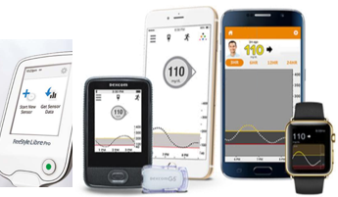
Benefit to Risk Assessment
Continuous Glucose Monitoring
Provide detailed glucose information on demand
Active protection for hypo- and hyperglycemia
21

Slide 22

Benefit to Risk Assessment
Alternative Therapy
Self-Monitored Blood Glucose
Periodic meter testing 4 to 6 times a day
Each test requires finger stick with lancet
Test is easy to perform using portable testing devices and strips
22

Slide 23
Benefit Assessment – Continuous Glucose Monitoring ^{1,2,3}
Benefit Assessment Criteria | Assessment for Continuous Glucose Monitoring (FreeStyle Libre - low risk, but high benefit)
Types of Benefits | Information can dramatically improve glucose control, avoiding long-term complications (blindness, kidney dysfunction, heart attack, stroke, loss of limbs). Improve quality of life. Decrease overall treatment costs. Fewer days of missed work. Trending and patterns of glucose over time with continuous glucose monitoring.
Magnitude of Benefit | More patients with continuous glucose monitoring versus control had a relative reduction of > 10% in glycated hemoglobin levels – a relative reduction of 10% in glycated hemoglobin levels is associated with a reduction of > 40% in the rate of development and progression of early diabetic retinopathy.
Likelihood of Experiencing One or More Benefits | High likelihood of experiencing benefits, as continuous glucose monitoring provides accurate information and alerts for most patients who wear it, and complication rates related to poor glucose control are extremely high
Duration of Effect | Benefits continue as long as the device is being used
Patients’ Perspective on Benefit | Alerts are particularly important for patients with hypoglycemia unawareness, during exercise, when driving, at night, and in pediatric patients. Devices are reimbursed.
Benefit Factors for Health Care Professionals or Caregivers | Parents of children with diabetes are alerted when their children are in a danger zone. Ability to see historical glucose trends and patterns over time.
Medical Necessity | Alternatives offer only periodic glucose readings and no alert protection
1. Diabetes Technol Thera. 2009; (June)11(Suppl 1): S11-S16. The Tale of Two Compartments: Interstitial versus blood glucose monitoring
2. Diabetes Ther. 2017 Feb;8(1):55-73. Flash Glucose-Sensing Technology as a Replacement for Blood Glucose Monitoring for the Management of Insulin-Treated Type 2 Diabetes: a Multicenter, Open-Label RCT
3. Diabetes Care 2018;41:1227-1234. Cost-effectiveness of Continuous Glucose Monitoring for adults with Type 1 Diabetes Compared with Self-Monitoring of Blood Glucose: The DIAMOND Randomized Trial
23

Slide 24
Risk Assessment – Continuous Glucose Monitoring ^{1,2,3}
Risk Assessment Criteria | Assessment for Continuous Glucose Monitoring
Types of Harms or Risks | Microvascular and macrovascular complications that can results in blindness, kidney dysfunction, heart attack, stroke, loss of limbs, poor quality of life, and death. Remove continuous glucose monitor sensor before MRI, CT scan, X-ray, or diathermy treatment.
Magnitude or Severity of Harms or Risks | Device-related deaths and serious adverse events are extremely rare for both continuous glucose monitoring and finger-stick methods.
Likelihood of Experiencing One or More Harms or Risks | Non-serious adverse events (pain, infection and irritation from adhesive) are mild and transient. Risks from self-monitoring of blood glucose (finger stick) are similar in nature (pain, infection), potentially more frequent with finger sticks, but generally less severe.
Duration of Exposure to the Population | Designed to be used 24/7, but can easily be removed by patient.
Patients’ Perspective or Tolerance (Intolerance) to Harms or Risks | Patients tolerate these risks well. They are similar to those seen with infusion sets for external insulin pumps. The benefits of increased, on-demand glucose information and active protection against dangerous excursions outweigh the mild risks.
False-Positive or False-Negative Results | Continuous glucose monitoring can produce false alerts or fail to alert. Risks of false negatives are not increased compared to finger sticks alone, where no alerts are provided. Finger stick false positives are uncommon and mitigated by calibration. During rapid changes in blood glucose, continuous glucose monitoring may lag behind, e.g., after meals, insulin use, or exercise.
1. NEJM 2008;359:1464-1476. The Juvenile Diabetes Research Foundation Continuous Glucose Monitoring Study Group.
2. Diabetes Care 2017;Dec; 40(12): 1631-1640. International Consensus on Use of Continuous Glucose Monitoring.
3. Diabetes Technol Ther. 2018 Jun;20(S2):S285-S291. Advances in Care for Insulin-Requiring Patients Without Closed Loop.
24

Slide 25
Discussion of Benefit to Risk – Continuous
Glucose Monitoring ¹⁻⁵
Active protection and increased information of continuous glucose monitoring outweighs minor risks without the burden of finger sticks.
Payers recognize benefits and will reimburse costs.
A recent meta-analysis showed that using continuous glucose monitoring results in a meaningful decrease in HbA1c in a broad population of people with diabetes, including individuals with Type 1, Type 2 and of different ages.
Several additional studies reaffirmed the ongoing health benefits of continuous glucose monitoring and is easily used by millions of people living with diabetes globally. Although relatively infrequent, removal of continuous glucose monitor sensor is required before MRI, CT scan, X-ray, or diathermy treatment.
A separate health economics analysis confirmed that use of the FreeStyle Libre system is associated with significant cost savings when compared to traditional blood glucose monitoring.
¹ Presented at the American Diabetes Association 78th Scientific Sessions. A Meta-Analysis of Real World Observational Studies on The Impact of Flash Glucose Monitoring on Glycemic Control as Measured by HbA1c.
² Presented at the American Diabetes Association 78th Scientific Sessions. Glucose Variability and Flash Glucose Monitoring in the Real World.
³ Presented at the American Diabetes Association 78th Scientific Sessions. Real-world Patterns of Daytime and Nocturnal Hypoglycemia during Flash Continuous Glucose Monitoring.
⁴ Presented at the American Diabetes Association 78th Scientific Sessions. Cost Calculation and Adherence to ADA Recommendations based on a Flash Continuous Glucose Monitoring System.
⁵ Data on file. Dunn T, Xu Y, Hayter G; Evidence of a Strong Association Between Frequency of Flash Glucose Monitoring and Glucose Control Measures During Real-World Usage
25

Slide 26
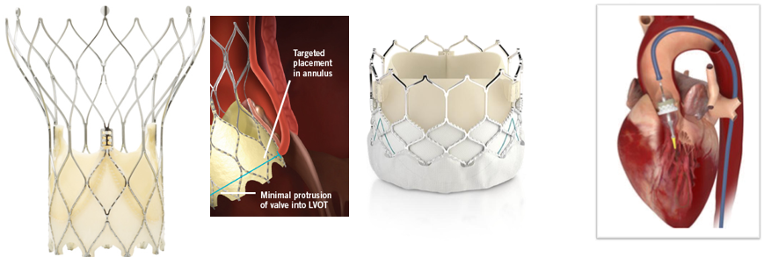
Benefit to Risk Assessment
Transcatheter Aortic Valve Replacement
Transcatheter Aortic Valve Replacement (TAVR) is a minimally invasive treatment for patients diagnosed with severe aortic stenosis
Compared to either medical therapy or surgical aortic valve replacement, TAVR provides excellent acute and long-term clinical outcomes including low rates of death, disabling stroke, and paravalvular leak.
Additional benefits observed included reduction in New York Heart Association (NYHA) class severity, low rates of bleeding, and improvements in a six-minute walk test, allowing patients to return to their previous lifestyles and activity faster.
26

Slide 27
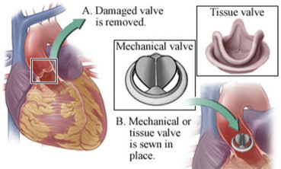
Benefit to Risk Assessment
Alternative Therapy
Standard Surgical Aortic Valve Replacement
Open heart surgery
Diseased valve removed and replaced
Requires patient to be a surgical candidate
27

Slide 28
Benefit Assessment – Transcatheter Aortic
Valve Replacement¹⁻³
Benefit Assessment Criteria | Assessment of Transcatheter Aortic Valve Replacement (High risk, alternative is death
Types of Benefits | Improved mortality, neurological benefits, recovery time, lower rates of atrial fibrillation, vascular complications and bleeding. Longer-term follow-up and additional RCTs have demonstrated that TAVR is equivalent to surgical AVR for severe symptomatic AS when surgical risk is high.
Magnitude of Benefit | All-Cause Mortality 1.1% versus 4.0% at 30 days. Disabling stroke 1.0% versus 4.4% at 30 days. Mean hospital stays of 5.6 days versus 11.9 days for surgery. Mean ICU stays of 2.7 days versus 5.6 days for surgery.
Likelihood of Experiencing >1 Benefits | Very high procedural success rates (>90%) with low paravalvular leakage.
Duration of Effect | All-Cause Mortality 7.4% vs. 13.0% at 1 year. Disabling stroke 2.3% vs. 5.9% at 1 year. Effects seen throughout the lifetime of the patient.
Patients’ Perspective on Benefit | Short procedure time. Quicker recovery (no sternotomy). Shorter hospital stay. Improve 6-minute walk tests. Improved Quality of Life.
Benefit Factors for Health Care Professionals or Caregivers | Shorter hospital stays and thus frees up hospital resources. Some implants can be re-sheathed and re-deployed, provided that the valve has not been fully released.
Medical Necessity | For patients suffering from symptomatic severe aortic stenosis, the alternative treatment is surgical aortic valve replacement
1. JACC 2017;70(2):252-89. AHA/ACC Focused Update of the 2014 AHA/ACC Guideline for the Management of Patients With Valvular Heart Disease
2. JACC 2014;63:2438-88. 2014 AHA/ACC guideline for the management of patients with valvular heart disease: executive summary; 3. https://www.ncbi.nlm.nih.gov/pmc/articles/PMC5317356
28

Slide 29
Risk Assessment – Transcatheter Aortic
Valve Replacement ^{1,2,3}
Risk Assessment Criteria | Assessment for Transcatheter Aortic Valve Replacement
Types of Harms or Risks in Patients with Aortic Stenosis (AS) | Angina pectoris, dyspnea, or syncope, or repeat hospitalization and/or death.
Magnitude or Severity of Harms or Risks | Annual mortality of 25% in those with moderate‐to‐ severe AS and average survival of only 2 to 3 years. Two‐year mortality rates can range from 44.4% for symptomatic AS patients to as high as 79% for predominant AS patients. Following symptomatic patients with severe AS in whom operation was declined, mortality rates of 45%, 63% and 75% at 1 year, 2 year, and 3 year follow‐up, respectively. More recently, it has been established that inoperable patients with severe AS had a 1‐year mortality rate of 50%.
Likelihood of Experiencing One or More Harms or Risks | 30-day risk of new permanent pacemaker was 10.2% versus 7.3% 30-day moderate or severe pulmonary valve regurgitation was 3.7% versus 0.5% 1-year moderate or severe pulmonary valve regurgitation 1.5% versus 0.4%
Duration of Exposure to the Population | Lifetime of the patient.
Patients’ Perspective or Tolerance (Intolerance) to Harms or Risks | Very low patient intolerance over the past 15 years.
False-Positive or False-Negative Results | Not applicable.
29

Slide 30
Discussion of Benefit to Risk – Transcatheter Aortic Valve Replacement ^{1,2,3}
Initially approved in 2011 for high surgical risk patients now being used for lower risk patients due to improved safety and performance of TAVR versus Surgery.
Decrease mortality rates over the lifetime of the device.
Current-generation devices improve control and accuracy in positioning and placement of the valve, minimizing paravalvular leak (a common complication with first-generation transcatheter valves) and potentially reducing the need for implantation of a permanent pacemaker after the procedure.
A separate health economics analysis confirmed that use of xxxz is associated with significant cost savings when compared to traditional blood glucose monitoring.
This complication is due to the anatomical proximity of the aortic valve to the atrioventricular (AV) node, bundle of His, and major conduction branches. The rate of PPI ranges from 3.4% to 17.3% for BEV and from 15.7% to 37.6% for SEV mostly as a result of complete atrioventricular block.[2
Catheter-based delivery of aortic valves avoids the need to place patients on cardiopulmonary bypass, which decrease procedural times and risks.
While tissue valves do not require anticoagulation therapy, they also do not last as long as mechanical valves.
1. JACC 2017;70(2):252-89. AHA/ACC Focused Update of the 2014 AHA/ACC Guideline for the Management of Patients With Valvular Heart Disease
2. JACC 2014;63:2438-88. 2014 AHA/ACC guideline for the management of patients with valvular heart disease: executive summary; 3. https://www.ncbi.nlm.nih.gov/pmc/articles/PMC5317356
30

Slide 31
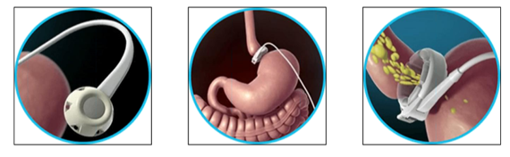
Benefit to Risk Assessment
LAP-Band (LAGB)
Laparoscopic Adjustable Gastric Banding for Weight Loss
The adjustable silicone band is equipped with an attached
inflatable balloon. This balloon is connected by a tube to an access
port under the skin.
LAP-Band or Laparoscopic Adjustable Gastric Banding (LAGB) for Weight Loss
Eat smaller meals and slowly – reversible. Needs ongoing adjustment and maintenance by MD
The band is positioned around the upper part of the stomach by keyhole (or laparoscopic) surgery so as to create a small pouch. This small pouch lies above the band and has a capacity of 15-20mL. The remaining stomach lies below the band. The band helps patients reduce weight by 2 mechanisms:
First, by reducing the amount of food that an individual wants to eat by inducing a feeling of fullness after only half a cup of food; and
Second, by slowing down the emptying from the pouch above the band, thereby prolonging the feeling of fullness
Since the insertion of the adjustable gastric band does not involve any stapling, resection or shortening of any part of the stomach or intestines, the function of the digestive system remains intact.
All ingested food will still be absorbed by the body the same way that it was before the operation.
Weight loss is achieved by helping induce early feeling of satiety after
eating considerably smaller amounts of food than before the surgery.
31

Slide 32
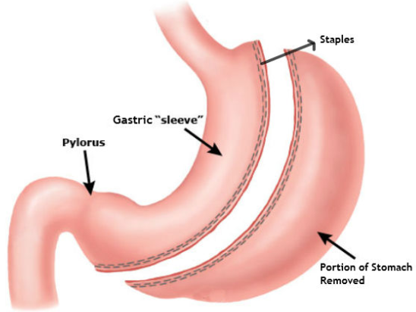
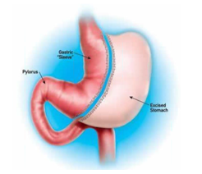
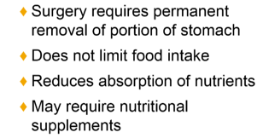
Benefit to Risk Assessment
Alternative Therapy
Gastric Sleeve Surgery
Surgery requires permanent removal of a portion of the stomach
Does not limit food intake
Reduces absorption of nutrients, thus may require nutritional supplements
Half of your stomach is not available – not reversible
32

Slide 33
Benefit Assessment – LAP-Band (LAGB)
Laparoscopic Adjustable Gastric Banding for Weight Loss
Benefit Assessment Criteria | Assessment of LAP-Band (LAGB) (Moderate risk with Favorable benefit
Types of Benefits | Rapid, sustained weight loss by restricting the amount and speed of caloric intake.
Magnitude of Benefit | Mean excess weight loss of 43.5% at 2 years. Weight loss impacts a multitude of co-morbidities including heart disease, diabetes, hypertension, hyperlipidemia, and joint problems.
Likelihood of Experiencing >1 Benefits | Multiple benefits are likely. The device imposes physical restrictions on the speed and amount of food intake.
Duration of Effect | Mean excess weight loss of 43.5% at 2 years with 60% of patients maintaining > 30% of excess weight loss at 2 years.
Patients’ Perspective on Benefit | Patients experience immediate and rapid weight loss, once they learn the kinds and amounts of food they can eat. Requires patients to make dietary changes to avoid adverse events.
Benefit Factors for Health Care Professionals or Caregivers | Provides another option for their patients or family members where diet, exercise and medications have failed, especially for those that are not comfortable with more invasive surgical options.
Medical Necessity | Lap-Band is for obese patients who have repeatedly failed to lose weight. Alternative options are more invasive surgical therapies including gastric bypass and gastric sleeves. Although very effective, these options may lose effect over time due to stomach stretching. They do not restrict intact, but rather absorptions of nutrient and require the use of supplements. They are also not fully reversible like the LAP-Band offers.
33

Slide 34
Risk Assessment – LAP-Band (LAGB)
Risk Assessment Criteria | Assessment for LAP-Band (LAGB) for Weight Loss
Types of Harms or Risks in Patients with LAP-Band (LAGB) for wt. loss | Risks and harms are primarily related to procedures with laparoscopic surgeries being riskier. LAP-Band surgery is performed using a slit in the skin. It is restrictive and does not cause malabsorption of nutrients, vitamin deficiencies are not usually seen.
Magnitude or Severity of Harms or Risks | Side effects include nausea and vomiting (29%), ulceration at the band site, esophageal reflux (14.8%), indigestion (22%), weight regain, and dehydration. LAP-Band mortality rate is about 1 in 2000. Other complications may include band slipping, infection, bleeding, and/or abdominal pain. These most common side-effects of the Lap-Band, however, are frequently associated with a lack of patient compliance and not a malfunction of the band itself.
Likelihood of Experiencing One or More Harms or Risks | There is ~20% probability of experiencing one or more harms or risks.
Duration of Exposure to the Population | Permanent device, but can be reversed or removed, unlike alternative options.
Patients’ Perspective or Tolerance (Intolerance) to Harms or Risks | Patients tolerate the risks of adjustable gastric bands well, provided adjustments are made. Gastric bypass or sleeve patients do not require this frequency of follow-up.
False-Positive/False-Negative | Not applicable.
LAP-Band or Laparoscopic Adjustable Gastric Banding (LAGB) for Weight Loss
34

Slide 35
Discussion of Benefit to Risk – LAP-Band (LAGB)
Weight loss is generally equivalent to alternative therapies.
LAP-Band (LAGB) maintenance requires ongoing surgeon interaction to adjust band.
Side effects are usually mild and include nausea and vomiting, ulceration at the band site, esophageal reflux (indigestion), weight regain, and dehydration. Since this type of surgery is restrictive and does not cause malabsorption of nutrients, vitamin deficiencies are not usually seen.
LAP-Band (LAGB) offers a shorter hospitalization and quicker recovery than gastric sleeve or bypass procedures. In general, most can return to work 1 week after surgery if their job is not too physically demanding. Normal activity can usually resume after 6 weeks.
Market adoption has been slow despite favorable benefit to risk analysis.
LAP-Band or Laparoscopic Adjustable Gastric Banding (LAGB) for Weight Loss
35

